Slide 1
Miniaturization Challenges in Optical Sensing

Slide 2

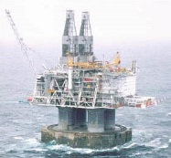

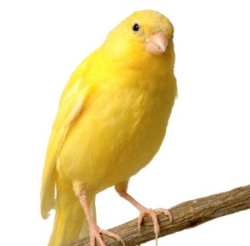

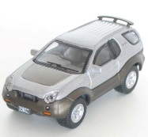

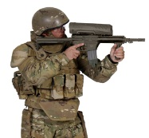
The market of optical Sensors
Environment/ Housing
Air Quality Monitoring & HVAC Management
Industry
Emissions & Process Control
Agriculture/ Agrifood
Precision Farming & Animal Husbandry
Transports
Emissions Reduction
Health
Health Screening & Early Disease Detection
MARKET VALUE:
~ 1 BILLION $ in 2021
CAGR ~ 7%/YEAR
Defense & Security
Detection of Illicit Substances

Slide 3
Optical sensing: Vision & trends
      Fives Topmost Keywords for Sensing:
        Footprint
        Power consumption
        Real time
        Multi Species (including PM)
        Portability and connectivity
eLichens: Personalized Air Quality
Plume Labs: The first smart air quality tracker
SenseAir: Make sense of air
mirSense: Sensing the world to make it a better place
Aryballe: Imagine if you could record a smell
Vaisala: Reliable environmental observations for better decision making, safety and efficiency.

Slide 4
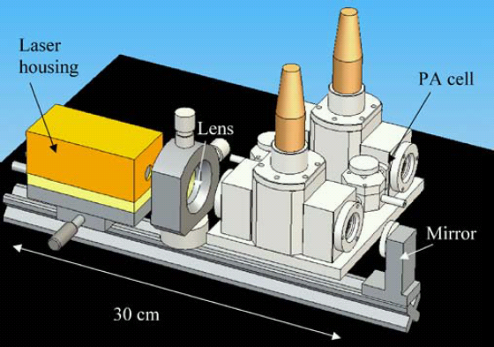
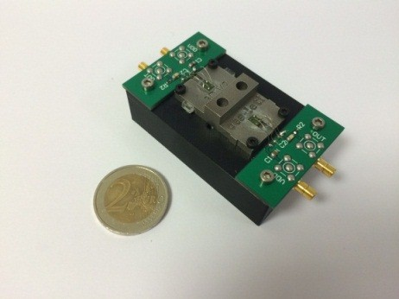
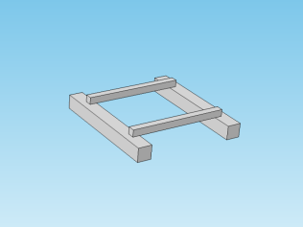
Benefits of the miniaturization: move sensing on planar substrate
  Approach
  Full MEMS fab - Combine Photonics with Fluidics IC and MEMS technologies
  Miniaturize functionalities on planar substrates
  Handle the full chain of sensing from sampling, to detection and data analyses
  Advantages
  Monolithic System-on-Chip/System-in-Packaging
  Lower the price by collective fabrication on planar substrate
  Shrink down size and volumes
  Reduce power consumption
Grossel et al., Appl. Phys. (2007)
Mini PA – Leti 2015
µ-PA cell (2.6 x 2.6 mm²)
– Leti Ongoing

Slide 5
Contribution of the Integrated Photonics – IR, Vis, UV
  Sources
  Extend the tunability range – liquids, solids, complex molecules
  Allows multi-wavelength capabilities - multi-gas, PM
  Beam handling, sorting and routing
  Guide the light from the source to the detector
  Combine sources of different wavelengths
  Sort wavelength bands from an extended source
  Reduce temperature and/or mechanical drift - monolithic assembly
  Detection
  Associate photonics and fluidics
  Develop miniaturized solutions for detection - chemicals
  Explore novel architectures at chip level – PM

Slide 6
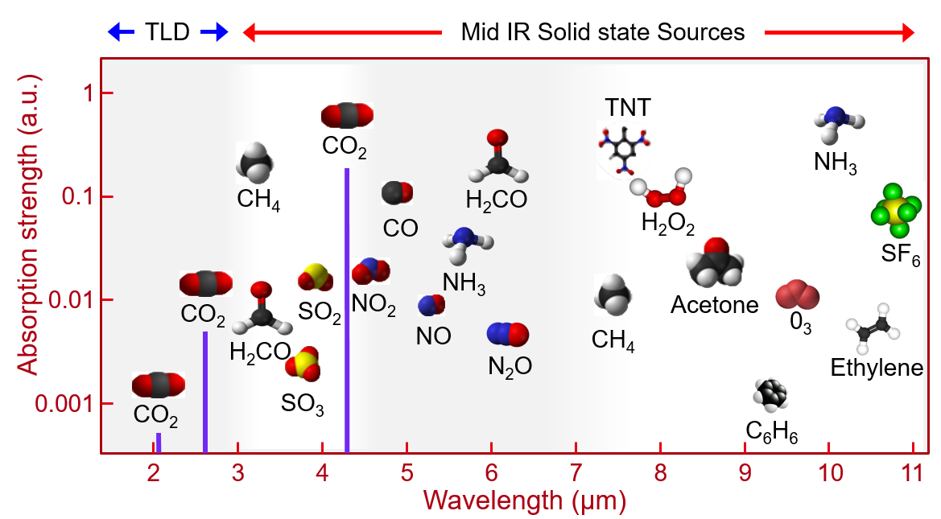
CHEMICAL DETECTION: WORKING IN THE MID-IR RANGE
Optical sensing:
  Enable identification, tracking and measuring of chemicals concentration down to trace level
Mid-IR wavelength band:
  Clear and intense “fingerprints” of molecules

Slide 7

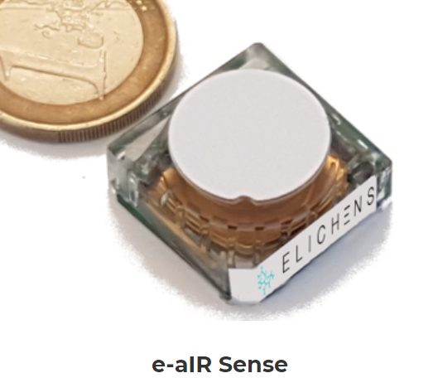
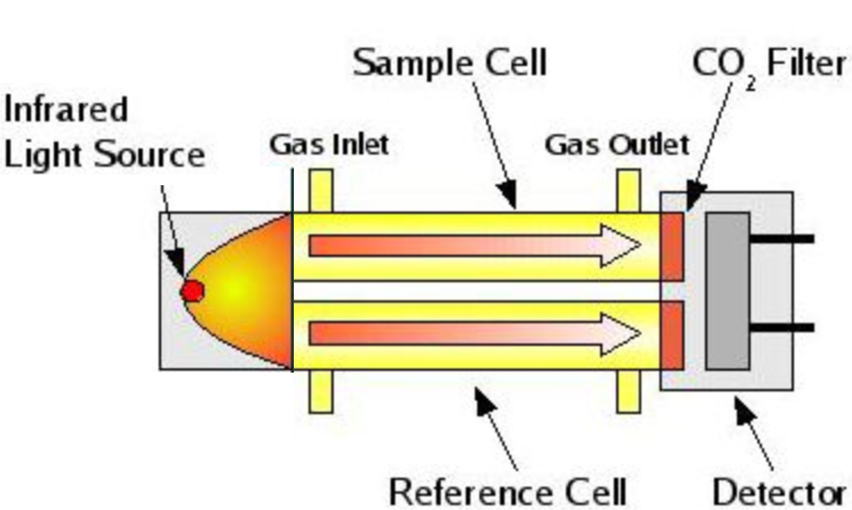
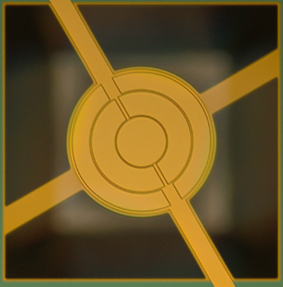

ULTRA LOW-POWER NDIR SENSOR
Micrograph of the IR source
Key figures
Low power consumption < 5 mW
Small footprint (~ 3 cm²)
Resolution: 20 ppm @1000 ppm concentration for CO₂ gas
Designed for CO₂ or CH₄
Reference channel

Slide 8
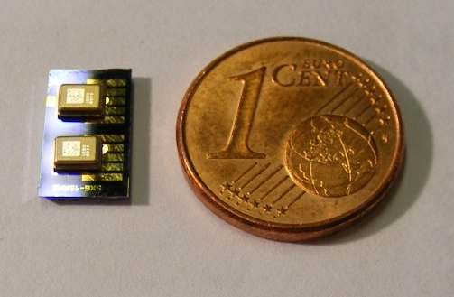

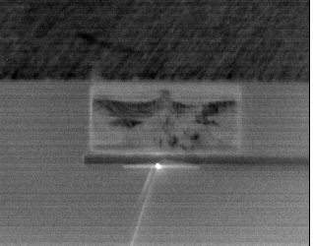
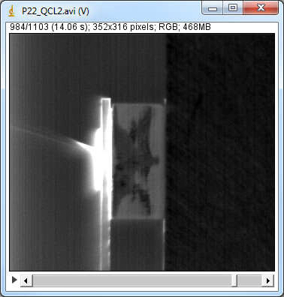
PHOTOACOUSTIC SPECTROSCOPY AT CHIP LEVEL
Si PA sensor
Key Figures:
Small footprint
Sub-ppm Resolution
Real time detection
Multi-Gas sensing
QCL source on Si
Key Figures:
RT Operation
3% duty cycle at 200 kHz
P_{out} ~ Few mW
Below Threshold
Above Threshold

Slide 9
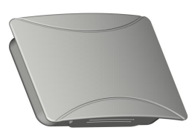
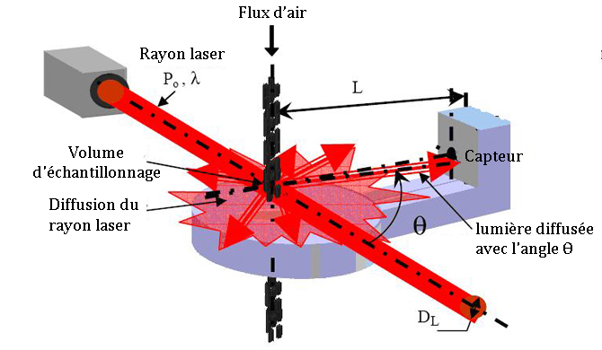
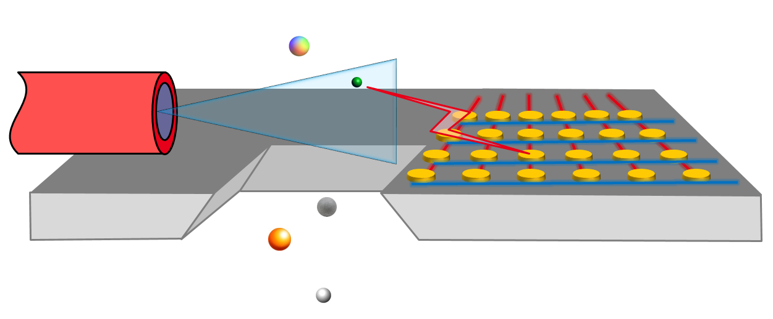
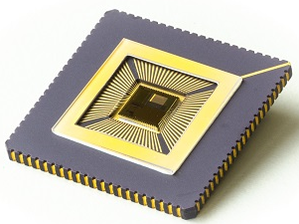
WHAT’S NEXT: MINIATURIZED PM SENSOR
Principle : scattering and back-scattering pattern imagery
Fluidic channel
with particules
Key figures:
Particle counting
Particle discrimination by size and nature
Die level: footprint < 1 cm²
Low cost < 10 €
Patent Pending

Slide 10
Summary
Our trusts:
Miniaturization to drive cost and power consumption reductions
Unique approach combining MEMS and Photonics technologies
Our offer:
From concept devices to SoC/SiP validation;
From Proof Of Concept to Prototyping & Industrialization

Slide 11


Meet Leti experts at Booth #431 French Pavilion
South Hall

